Slide 1
Tax Payments Made & Credits
Pub 4012 Tab H
Pub 17 Chapter 4
(Federal 1040-Lines 64-74)
(NJ 1040-Lines 48 & 50)
Notes:
1

Slide 2
Types of Payments & Credits
Can be applied against tax liability
Federal and NJ
Income tax withheld from W-2s, W-2Gs, 1099s, etc.
Estimated tax payments
Amounts applied from prior year’s return
Payments made with a request for extension of time to file
Earned income credit
Federal Only
Additional child tax credit
Refundable American Opportunity credit
NJ Only
Property Tax Credit
Excess UI / DI / FLI
Notes:
2

Slide 3
Income Tax Withholding – 1040 Line 64 / NJ 1040 Line 48
Collected by employer
Set aside from pensions, Social Security
Set aside from bonuses, commissions
Set aside from gambling winnings
TaxSlayer – automatically totals from data entry for individual forms & populates on 1040 Line 64 or NJ 1040 Line 48
Notes:
3

Slide 4
Estimated Tax Payments – Federal 1040 Line 65 / NJ 1040 Line 50
Means of tax payment for:
Self-employed
Those with investment income
Projected Federal balance due > $1,000
Taxpayers with NJ projected balance due > $400 should file NJ estimated tax payments
Payments made periodically by taxpayer (usually due on 4/15, 6/15, 9/15 and 1/15 of subsequent year-may change due to holidays)
Need to know “When” & “How Much” for each 2015 estimated tax payment made
Estimated tax payments are made separately from tax return
Particularly important for payment due 4/15
Notes:
4

Slide 5
Overpayment From Previous Year
Could have elected to have 2014 refund applied to 2015 tax liability
Ask taxpayer if 2014 refund was applied to 2015 taxes or check 2014 tax return
Notes:
5

Slide 6
Estimated Tax Payments Example Davis Family
The Davis family made the following Federal estimated tax payments:
On 04/12/2015 tax payment of $250
On 06/11/2015 tax payment of $250
On 09/15/2015 tax payment of $250
On 01/05/2016 tax payment of $250
The Davis family did not choose to apply any of last year’s refund to this year’s tax liability
Notes:
6

Slide 7
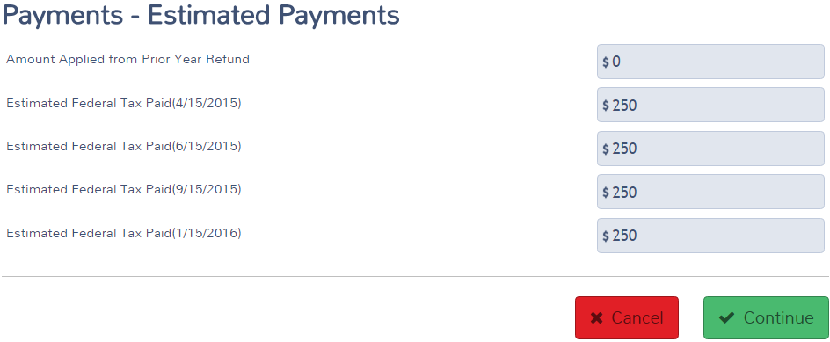
TS - Federal Estimated Taxes Paid and Amount Applied from Prior Year Federal Section \ Payments and Estimates \ Federal Estimated Payments for 2015
From taxpayer or prior year return
Federal estimated tax payments
Notes:
7

Slide 8
NJ Estimated Taxes Paid and Amount Applied from Prior Year
Enter in Federal Section \ Payments and Estimates \ State Estimated Payments
Report:
2015 NJ estimated tax payments paid in 2015 or January 2016
Enter final 2015 estimated tax payment on proper line depending on whether it was paid before end of 2015 or in January 2016
Refund from 2014 tax return applied to 2015
Notes:
8

Slide 9
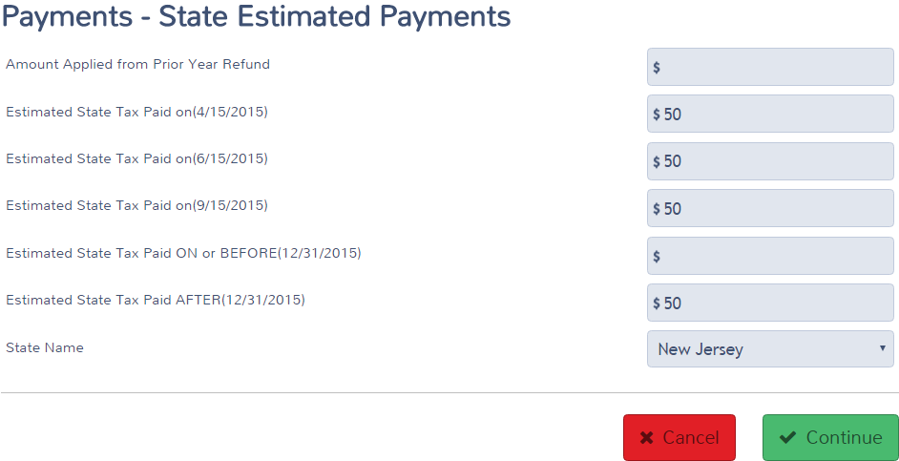
TS - NJ Estimated Taxes Paid and Amount Applied from Prior Year Federal Section \ Payments and Estimates \ State Estimated Payments
From prior year refund
NJ estimated tax payments
Enter final estimated tax payment on proper line
to show if payment made before or after 12/31
Notes:
9

Slide 10
NJ Estimated Tax Payments: What Amounts Are Transferred Where
Sch A Line 5a State & Local Taxes includes payments made in current tax year for any year’s tax due:
2015 estimated tax payments paid in 2015 only
From State Estimated Taxes screen
Refund from 2014 return applied to 2015
From State Estimated Taxes screen
2014 (or prior) tax payments paid in 2015
From Itemized Deductions \ Taxes You Paid screen
Final 2014 estimated tax payment paid in January 2015
From Itemized Deductions \ Taxes You Paid screen
NJ 1040 Line 50 includes payments applied to current year’s tax due, no matter when paid:
2015 estimated tax payments paid in 2015 or 2016
Refund from 2014 return applied to 2015
Notes:
10

Slide 11
TS – State Estimated Payments Screen – Schedule A Amount (Amounts Paid in 2015)
TS totals & transfers to Schedule A Line 5a
Not transferred to Schedule A Line 5a
because it was not paid in 2015
Notes:
11

Slide 12
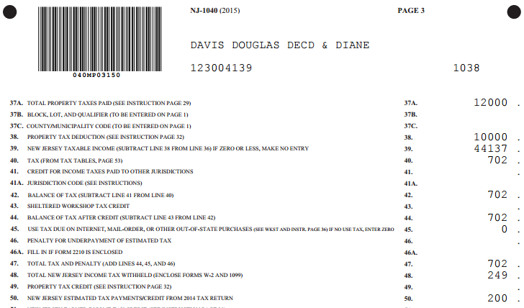
TS - NJ 1040 Line 50 – State Estimated Taxes Paid and Amount Applied from Prior Year (No Matter When Paid)
Current year NJ estimated tax payments (no
matter when paid) and amount applied from
prior year refund
Notes:
TS will transfer total of last year’s refund applied to current year + NJ estimated tax payments to NJ 1040 Line 50
12

Slide 13
Refundable Credits – Federal 1040 Lines 66a thru 68
Earned Income credit (Line 66a)
Since this must be calculated after all other figures are finalized, EIC is discussed in a later module
Additional Child Tax credit - refundable credit discussed in Child Tax Credit module (Line 67)
American Opportunity Credit (Line 68)
Since this must be calculated after all other figures are finalized, refundable AOC is discussed in a later module
Notes:
13

Slide 14
Payments Made With Extension of Time To File Federal 1040 Line 70 / NJ 1040 Line 50
Taxpayer requests extension of time to file
Must pay estimated balance due with extension
Must be sent by regular tax filing date
Complete Federal Form 4868
Complete NJ Form 630
Amount paid with extension is reported on Federal 1040 Line 70 or NJ 1040 Line 50 when final return is filed later
Cannot be e-filed. Must be sent via mail
Must submit final return by Oct. 15
Notes:
14

